Slide 1
Airline Flight Management System
Team 2

Slide 2
Team Contributions
Jason Paul Darivemula (002198774):
ERD Diagram & Logic, DDL & DML Scripting, Views ,Package - Booking
Dhanush Kumar Shankher:
ERD Diagram & Logic, DDL & DML Scripting, Views, Function, Triggers
Babuaravind Gururaj (002798604):
ERD Diagram & Logic, DDL & DML Scripting, Views, Package - Airline, Documentation
Rohith Chevvakula (002106577):
ERD Diagram & Logic, DDL & DML Scripting, Views, Package - Airline
Vikash Singh (002929181)
ERD Diagram & Logic, DDL & DML Scripting, Views, Package – Airline, Reports, Presentation

Slide 3
Problem Statement
The airline reservation system is a database project aimed at managing flight bookings and reservations for an airline company. The project involves designing a database schema, creating tables, defining relationships between tables, and implementing SQL queries to manage the booking process.

Slide 4
Objectives
Design a system that will streamline the process of flight reservation in a centralized, real time accessible manner
The system should be able to handle multiple flights and routes offered by the airline
Customers should be able to book for their flights online for multiple passengers
Customers should be able to apply a promotion code per booking
The system should keep track of seat availability and ensure that double-booking does not occur
The system should allow airline staff to manage flight schedules, customer bookings, and other aspects of the booking process
The system should provide reports and analytics to help the airline company make data-driven decisions

Slide 5
Proposed Solution
Our project is to develop a database dedicated to the Flight Reservation System component of an Airline company, say for example American Airlines.
The business requirement is restricted to the flights exclusive to the Airline company. Note that this is different than general ticketing systems like Kayak or Expedia which allows users to book flight tickets from multiple Airlines.
This document outlines the problem statement and the objectives of the team.
We also provide the Entity Relationship diagram of our proposed database structure and a detailed listing of our entities along with the sql scripts to build the entire system.

Slide 6
Concepts Executed
Stored procedures
Functions
Packages
Grants
Views
Triggers
Sequence
Exception Handling
Reports

Slide 7
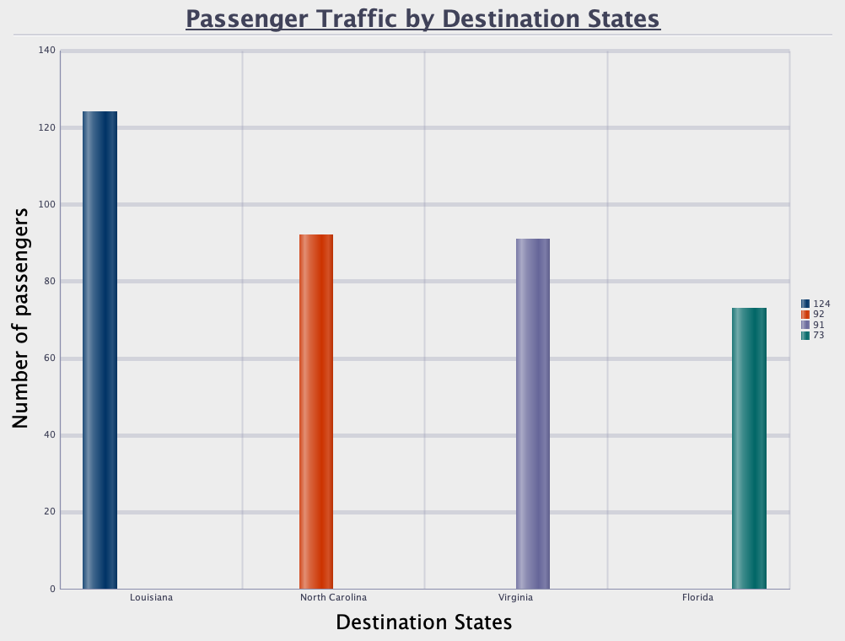
Reports
Passenger Traffic By Destination States

Slide 8
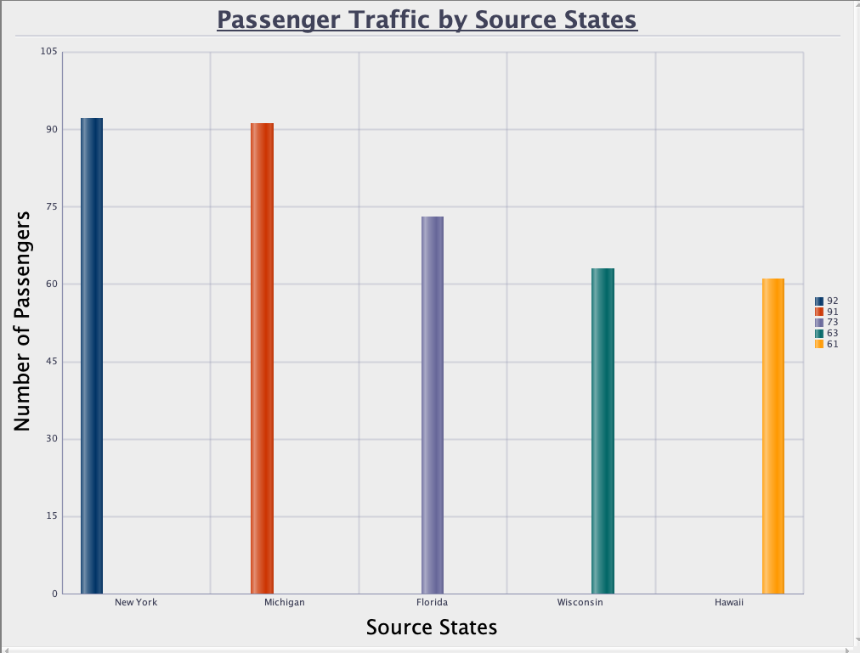
Reports
Passenger Traffic By Source States

Slide 9
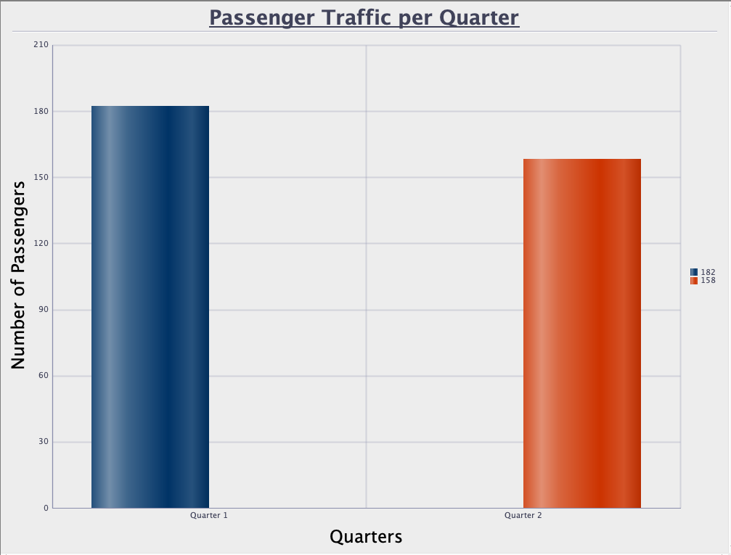
Reports
Passenger Traffic per Quarter

Slide 10
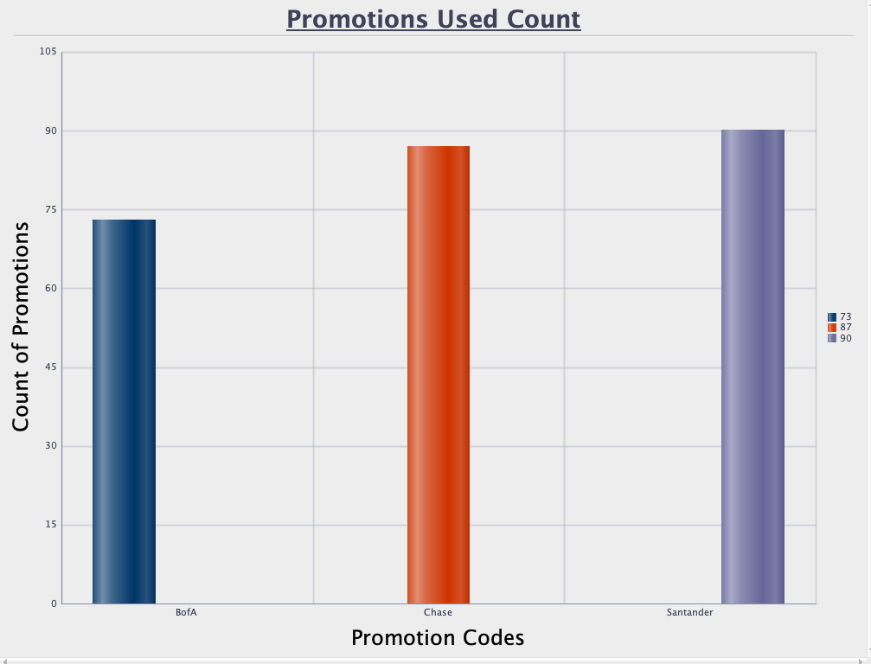
Reports
Promotions User Count

Slide 11
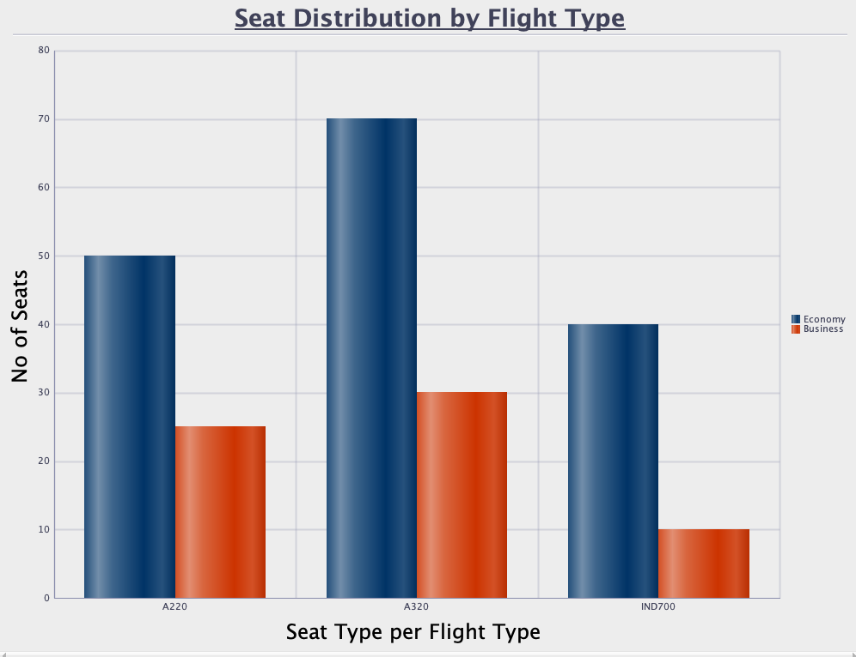
Reports
Seat Distribution by Flight Types

Slide 12
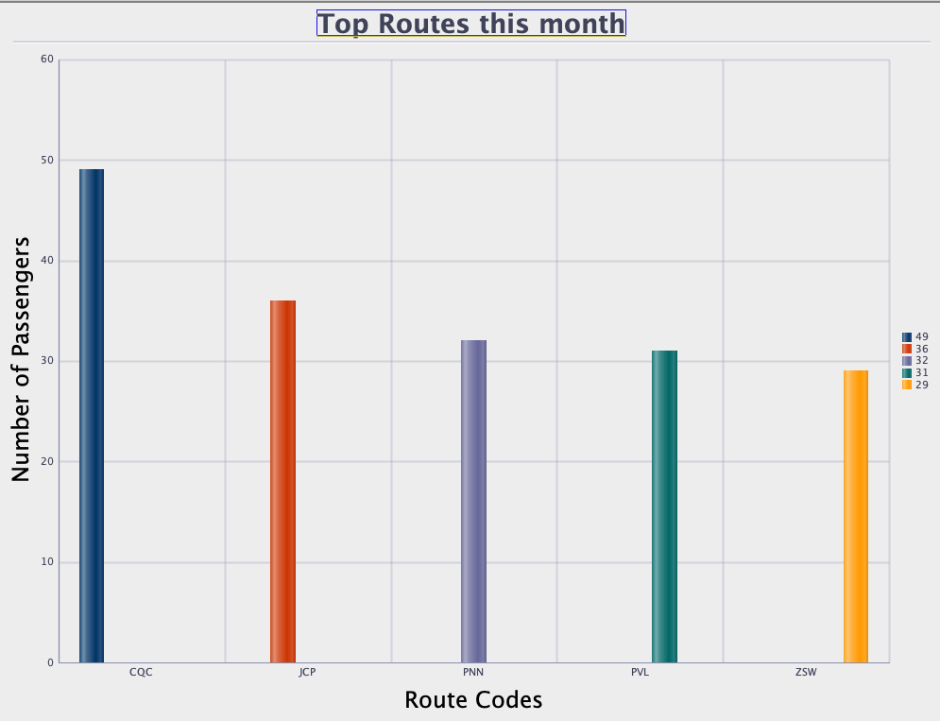
Reports
Top Routes this month

Slide 13
Thank you!!

